Slide 1
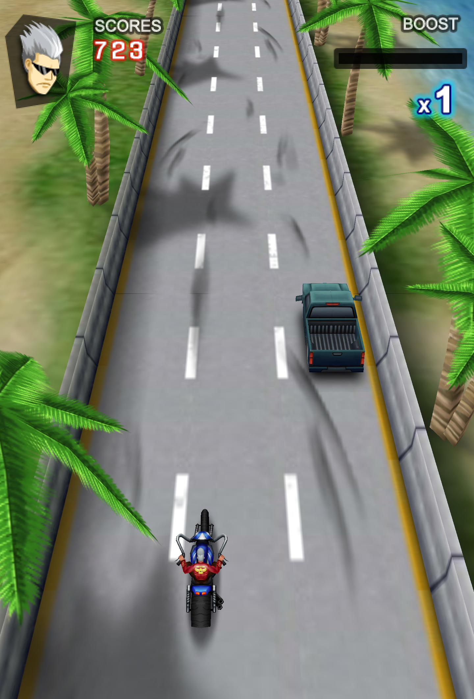
GamePal
(A hand-held gaming companion)
-by Atharv More & Mayuresh Pitale

Slide 2
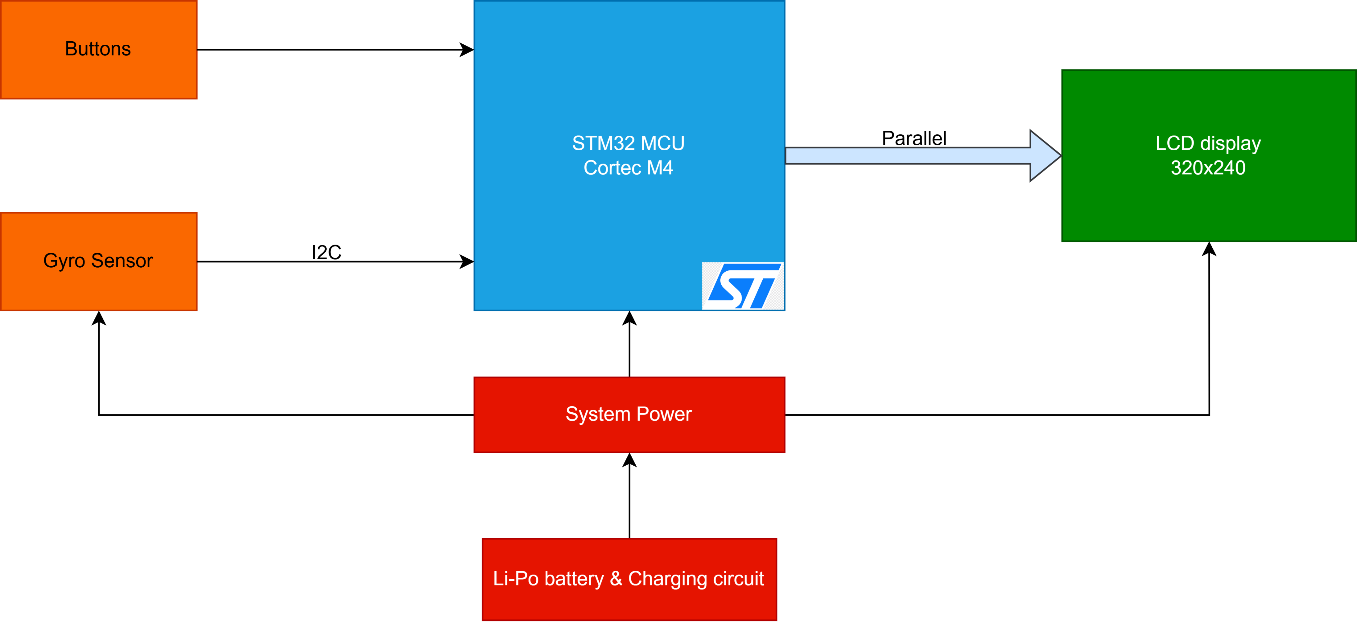
Hardware Elements

Slide 3
Software Elements
Software Architecture Overview
Main Game Loop:
  Initializes hardware and game state.
  Continuously reads inputs, updates game logic, and renders the display.
New Software Modules:
  LCD Driver: Manages screen initialization and pixel buffer updates.
  Gyro Driver: Reads and interprets angular velocity data for steering input.
  GPIO Handler: Manages button press detection with debouncing.
  Game Logic:
    Player Control: Translates gyro data and button presses into motorcycle movement.
    Obstacle Engine: Procedurally generates and manages obstacles on the track.
    Physics & Collision: Handles collision detection between the player and obstacles.
    UI Manager: Renders the score, speed, and game-over screens.

Slide 4
Key Milestones & Deliverables
30 Oct.
Finalize PCB schematic layout and ordering of parts required.
1 Nov.
Order PCBs and all electronic components.
16 Nov.
Firmware of the complete project.
25 Nov.
Assembly, testing and debugging of hardware and software
25–30 Nov.
Buffer time.
30 Nov.
Final game ready.
4 Dec.
Final Demo presentation & submission

Slide 5
Deliverables & Fall-back Plan
Project Deliverables
A fully functional, custom-built handheld moto racing game.
Complete PCB design files for the custom PCB.
Well-documented source code for the STM32 microcontroller.
A final demonstration video of the working prototype.
Future Scope: External memory for additional games.
Fall-back Plan
In the event of critical PCB manufacturing errors or hardware failures, the project will be implemented on a STM32F411E-disco board. All peripherals (LCD, gyro, buttons) will be connected via a zero PCB to ensure the software and gameplay functionality can still be delivered.

